Slide 1
Big Mountain Price Model Proposal
Prepared by: Stephen Dodd

Slide 2
TOC
Overview
Results
Problems to solve
Results, cont’d.
Recommendations
Analysis
Modelling
Summary

Slide 3
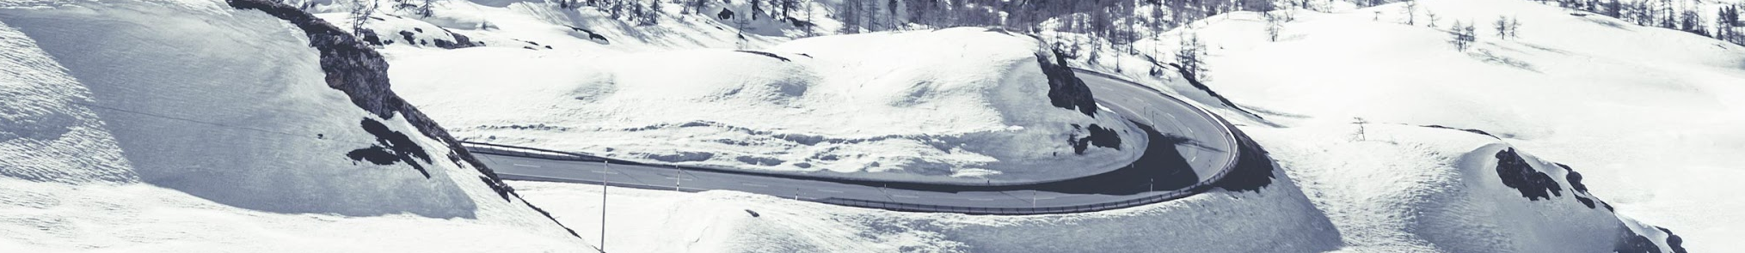
Overview
Big Mountain is a successful ski resort, hosting approximately 350,000 visitors annually. Big Mountain stands out in most metrics in its market segment, and in the state of Montana. Big market management recently took the initiative to add an additional chair lift and is interested in getting more specific with pricing, as the strategy has been “above the market average”.

Slide 4
Problems to solve
Determine an optimal ticket price.
What cost cutting measures can be taken, with minimal decreases in ticket price.
1
3
2
What, if any, improvements it can be made to amenities in order to support higher ticket prices.
4
Offset the cost of a recently installed chair lift.

Slide 5
Recommendations
Big Mountain should close the three least used runs, add an additional 150 ft to its vertical drop, by increasing the length of the longest run, with added snow making ability and an additional chairlift, and increase the price to $91.50.

Slide 6


Model
01
The model used was a Random Forest Model. This model gave a slightly better predictive value than a linear regression model. The drawbacks of this model include a possibility of overfitting, however it did ultimately perform better than the linear regression model.
QUICK TIP
Try right clicking on a photo and using "Replace Image" to show your own photo.

Slide 7

Results
02
Our results clearly demonstrated that Big Mountain is underpriced by over $10.00.
Additional results:
Adding to vertical drop by 150’ with an additional chair lift and run will support a price increase of $.85.
Adding snowmaking acres doesn’t improve the price in conjunction with the aforementioned improvements, beyond that of those improvements.

Slide 8
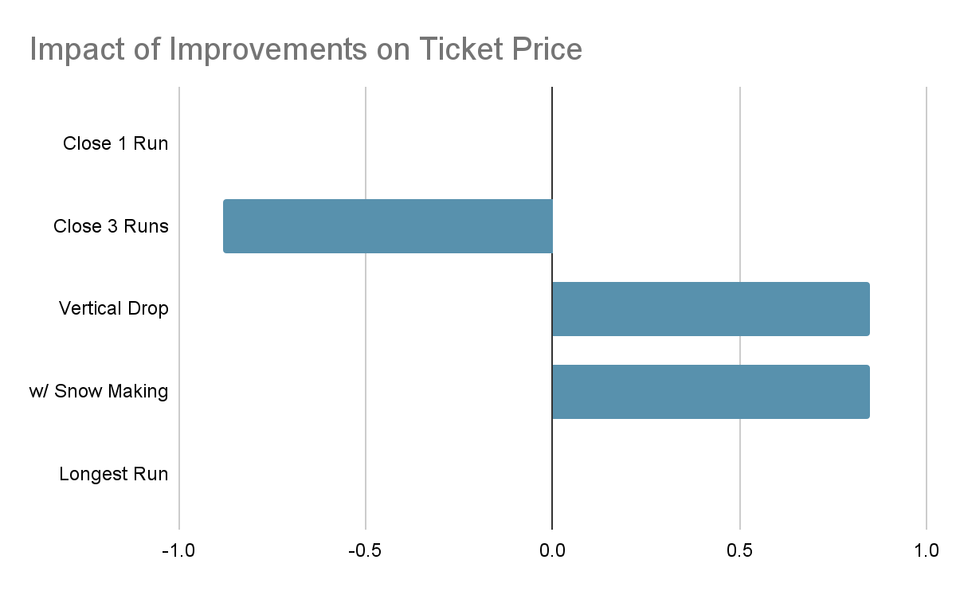
Results, cont’d
Closure of one run will not necessitate a price decrease, and closing 2 to 3 runs would require decreased price of $.88 per ticket.
Adding length to the longest run and additional snow making does not improve price.

Slide 9
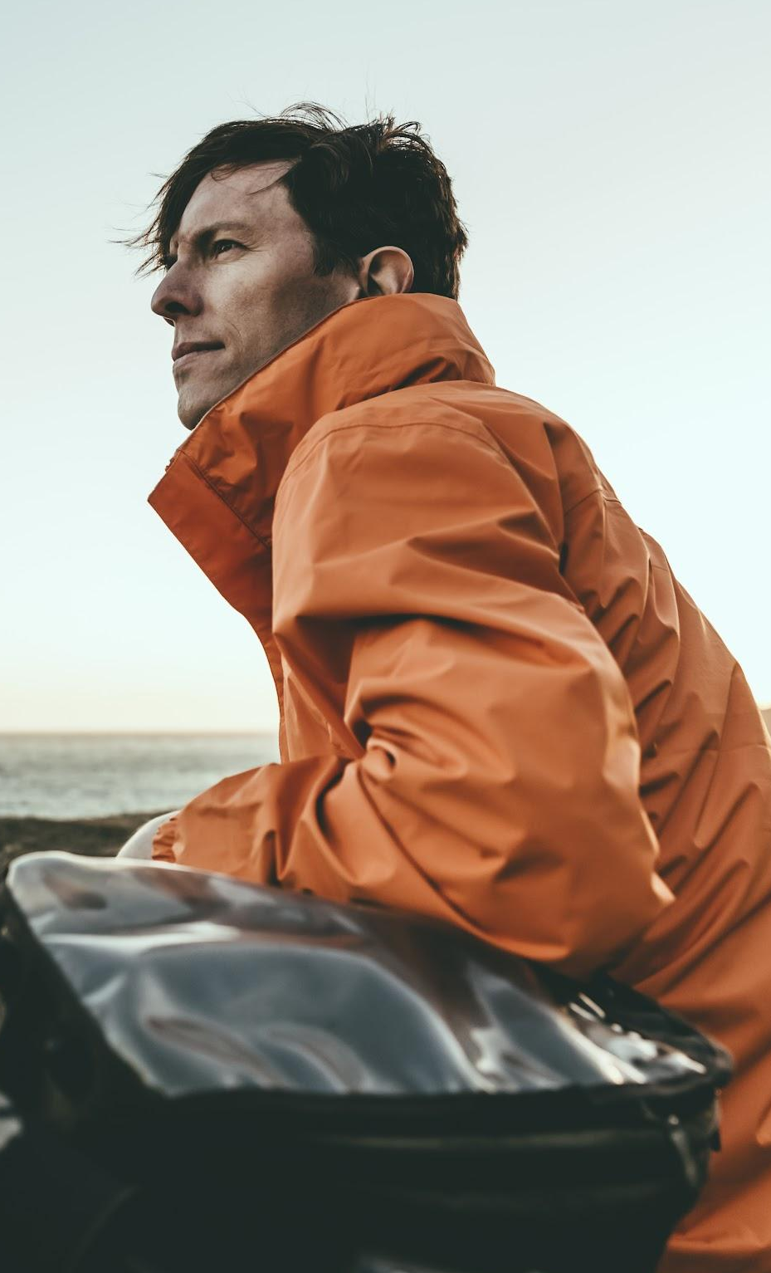

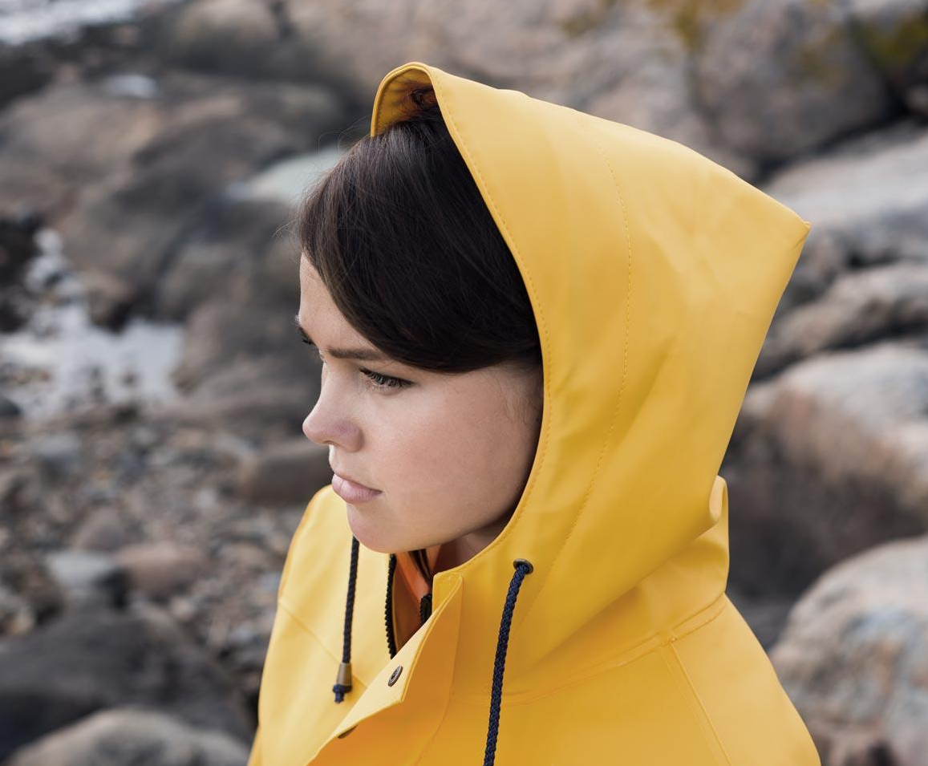
Analysis
There is a caveat to my findings, which is that without access to operating costs, it’s unclear how much costs will decrease with the closure of each run, so it’s possible that closing more runs would be more beneficial.
Additionally, this recommendation is made assuming that the costs of maintaining three runs is at least equivalent to $.03 per ticket. If it is not, then perhaps only closing one run is the best option.
Lastly, while the ticket price increase doesn’t entirely offset the cost of adding an additional run and chairlift and extending the vertical drop, the results show this to be an important feature for guests, and would likely support a higher price as well as draw more visitors.

Slide 10
Summary
Big Mountain should increase ticket price to approximately 91.50 per day. Without consideration to excluded data, Big should close 1 to 3 of the most unpopular runs and add to its vertical drop.

Slide 11
Thank you.

